Slide 1




Deep Belief Network Using Restricted Boltzmann Machines
Adarsh Sai Gupta
105181433
Anshul Sharma
110016388
Rishav Chatterjee
110010348

Slide 2
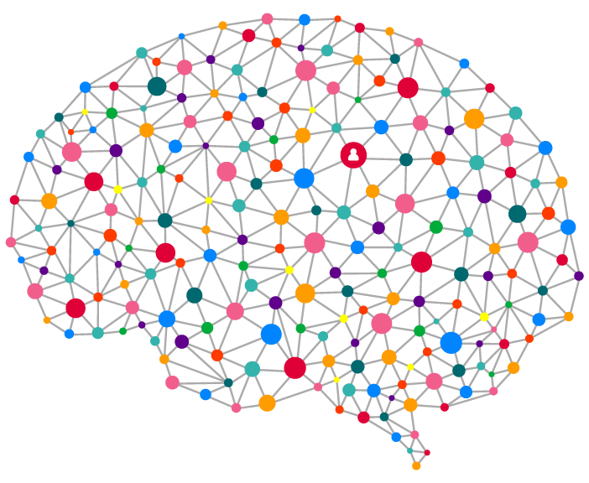
Abstract
When talking about deep learning the simplicity, scalability, flexibility and adaptive computation time of a model are some of the significant aspect of measuring the performance metric. With progress in the field of AI, it became possible to process complex tasks like recognizing features like real-life objects and human speech. However, with advancement in AI, came new challenges such as the vanishing gradient problem and redundant features. This led to the rise in RBM & DBN.

Slide 3
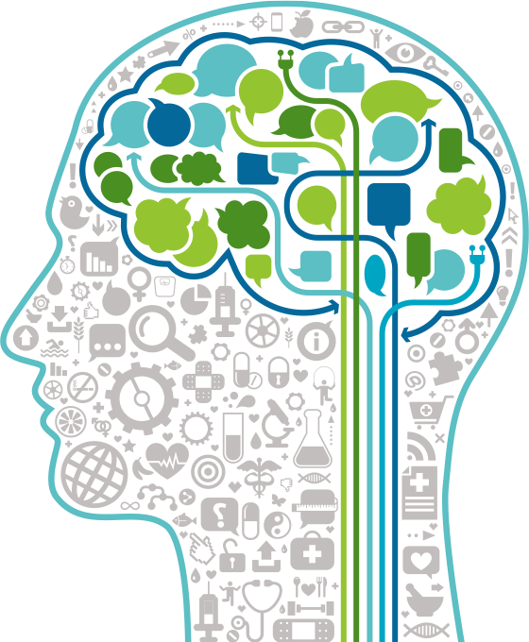
Contents
Introduction
History, Definition and Applications of RBM
Architecture of RBM
Comparison with GBM & Deep-Belief Networks
Energy-Based & Probabilistic Model
RBMs vs Autoencoders
Training RBM
Gibbs sampling, Contrastive Divergence
Results of RBM
Applications of RBM
Collaborative Filtering, Dimensionality Reduction
Deep Belief Network
Training of DBN
Results of DBN
Applications of DBN
Conclusion

Slide 4
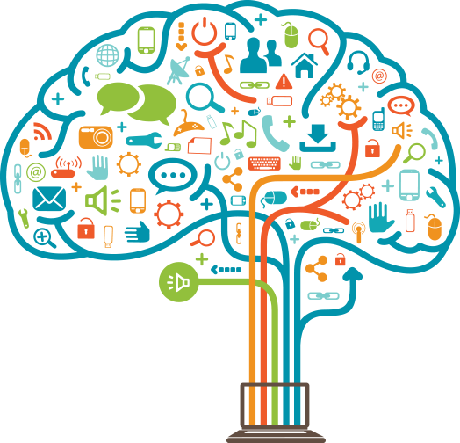
Introduction
History
Boltzmann machine was invented in 1985 by Geoffrey Hinton. RBM was invented by Paul Smolensky in 1986.
Named after the Boltzmann Distribution, which is an integral part of Statistical Mechanics and helps us to understand the impact of parameters like Entropy and Temperature in Thermodynamics. That’s why they are called Energy-Based Models (EBM).
Definition
RBMs - are non-deterministic (or stochastic) Generative Deep Learning models - are a special class of Boltzmann Machines and they are restricted in terms of the connections between the visible and the hidden units. This makes it easy to implement them when compared to Boltzmann Machines.
Applications
Used for dimensionality reduction, collaborative filtering, classification, regression, feature learning, and topic modeling.
Real-life implementation is ‘Netflix Prize’ which is a Advanced Recommender System for prediction using Collaborative filtering.

Slide 5
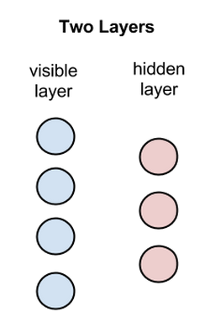
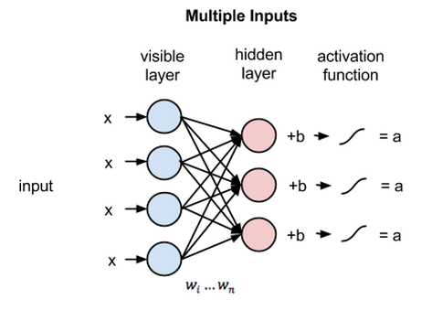
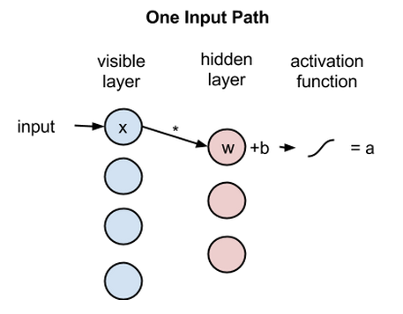
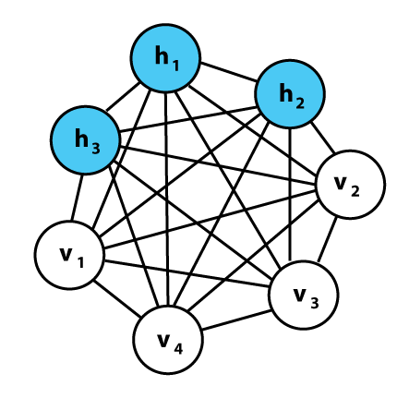
Architecture of RBM vs General Boltzmann Machine
A two-layered neural network, one being the visible layer and the other one being the hidden layer. These two layers are connected by a fully bipartite graph.
Each circle in the graph above represents a neuron-like unit called a node, and nodes are simply where calculations take place.
The nodes are connected to each other across layers, but no two nodes of the same layer are linked, that is, there is no intra-layer communication – this is the restriction in a restricted Boltzmann machine
In the forward pass, an RBM takes the inputs and translates them into a set of numbers that encode the inputs. In the backward pass, it takes this set of numbers and translates them back to form the re-constructed inputs.
For simple feed-forward movements, the RBM nodes function similar to an autoencoder.
Visible layer Hidden layer

Slide 6

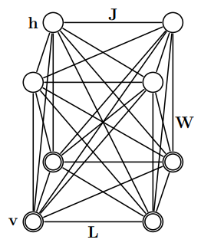
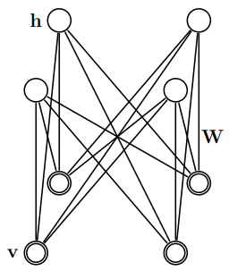
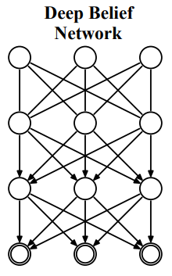
Architecture of RBM
vs Deep Belief Network
General Boltzmann Machine
Restricted Boltzmann Machine
Deep Belief Network

Slide 7
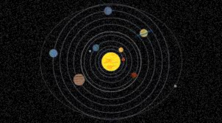
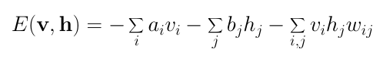
Energy-Based Model
Some deep learning architectures use the idea of energy as a metric for measurement of the models quality. Energy is defined through the weights of the synapses, and once the system is trained with set weights(W), then system keeps on searching for lowest energy state for itself by self-adjusting.
One purpose of deep learning models is to encode dependencies between variables. The capturing of dependencies happen through associating of a scalar energy to each configuration of the variables, which serves as a measure of compatibility. A high energy means a bad compatibility. An energy based model tries always to minimize a predefined energy function. The energy function for the RBMs is defined as,
where v_{i} is binary state of visible neurons and h_{j} is binary state of hidden neurons. a_{i} and b_{j} are biases corresponding to visible and hidden neurons, respectively, w_{ij} are weights connecting visible and hidden neurons. As it can be noticed the value of the energy function depends on the configurations of visible states, hidden states, weights and biases.
The training of RBM consists in finding of parameters for given input values so that the energy reaches a minimum.

Slide 8
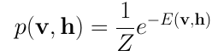
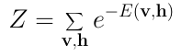
Probabilistic Model
Restricted Boltzmann Machines are probabilistic. At each point in time the RBM is in a certain state. The state refers to the values of neurons in the visible and hidden layers v & h respectively.
Probabilistic learning is a special case of energy-based learning where loss function is the negative log-likelihood.
The probability that a certain state of v and h can be observed is given by the following joint distribution:
Here Z is called the ‘partition function’ that is the summation over all possible pairs of visible and hidden vectors.

Slide 9

RBM vs Autoencoders
RBMs are a 2 layer architecture composed of a visible and a hidden layer. The visible layer is also called input layer.
RBM uses stochastic approach.
Learning procedure consists of several steps of Gibbs sampling and adjusting the weights to minimize reconstruction error.
The task of training is to find out how these two sets of variables are actually connected to each other.
AEs are a 3-layer architecture composed of an input, a hidden and an output layer. The output layer is a reconstruction of the input through the activations of the much fewer hidden nodes.
AEs uses deterministic approach.
Learning procedure consists of passing data through a network, where it first compresses input vector to "fit" in a smaller representation, and then tries to reconstruct it back.
The task of the training is to minimize an error of reconstruction in such a way that we require the minimal information to encode the image so that it be can regenerated on the other side.

Slide 10
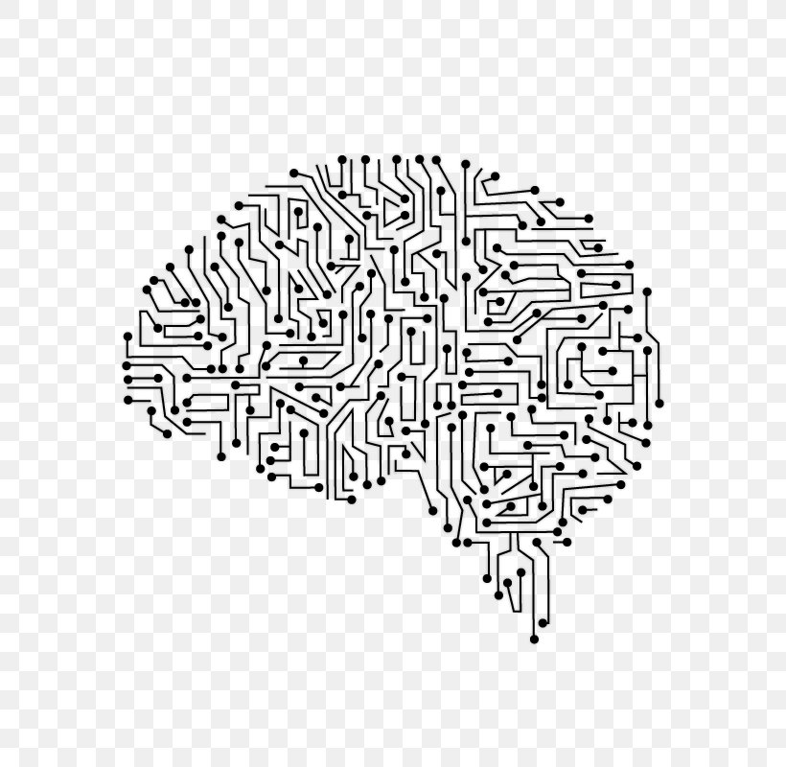
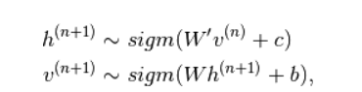
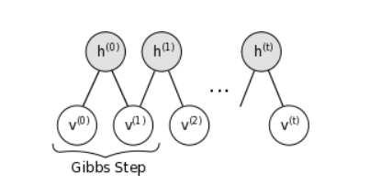
Training of RBM Gibbs Sampling
Usual Practise of Training- trained using the Contrastive divergence learning procedure
Practical experience to decide how to set the values of numerical meta-parameters.
h(n) -hidden units at the n^{th} step of the Markov chain.
hi(n+1) - is randomly chosen to be 1 (versus 0) with probability sigm(W’v(n)+c)

Slide 11
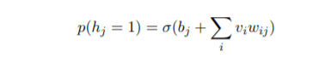
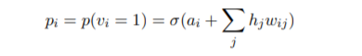

Collect Statistics
Updating the hidden states
Updating the visible states
Collecting the statistics needed for learning
v-randomly selected training image
h_{j}- the binary state
∆w_{ij} - Change in weight
σ(x)- is the logistic sigmoid function
1/(1 + exp(−x))
a_{i} , b_{j} are their biases
A recipe for getting the learning signal for CD

Slide 12
Steps Involved in Training RBM
The size of a mini-batch
Monitoring the progress of learning
A recipe for using the reconstruction error

Slide 13
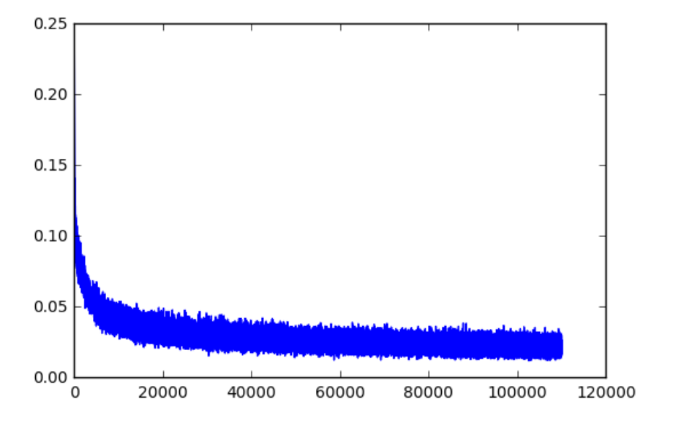
Progress of Learning
The following graph is obtained from Bernoulli-Bernoulli RBM on MNIST dataset.
X-axis: Number of Steps
Y-axis: Train Error

Slide 14

Training RBM
Steps Involved
Monitoring the overfitting
The learning rate
The initial values of the weights and biases
(small random values chosen from a zero-mean Gaussian with a SD of 0.01)
Momentum
Weight Decay (typically range from 0.01 to 0.00001)

Slide 15
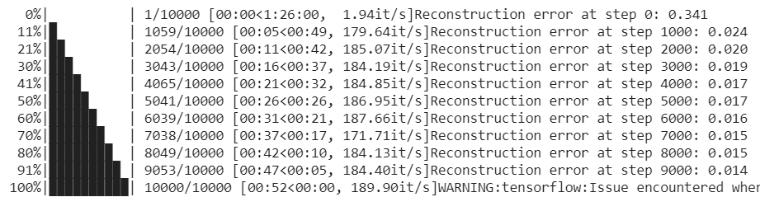
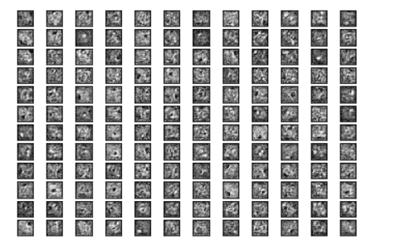
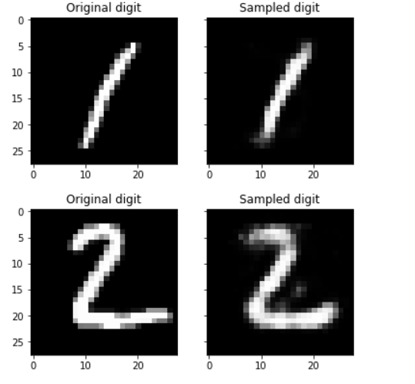
Results on MNIST Dataset
Number of Samples trained on each step displayed with the Reconstruction error:
Feature Table:
Reconstruction:

Slide 16
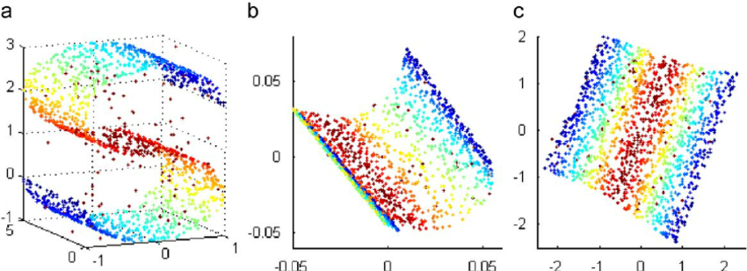
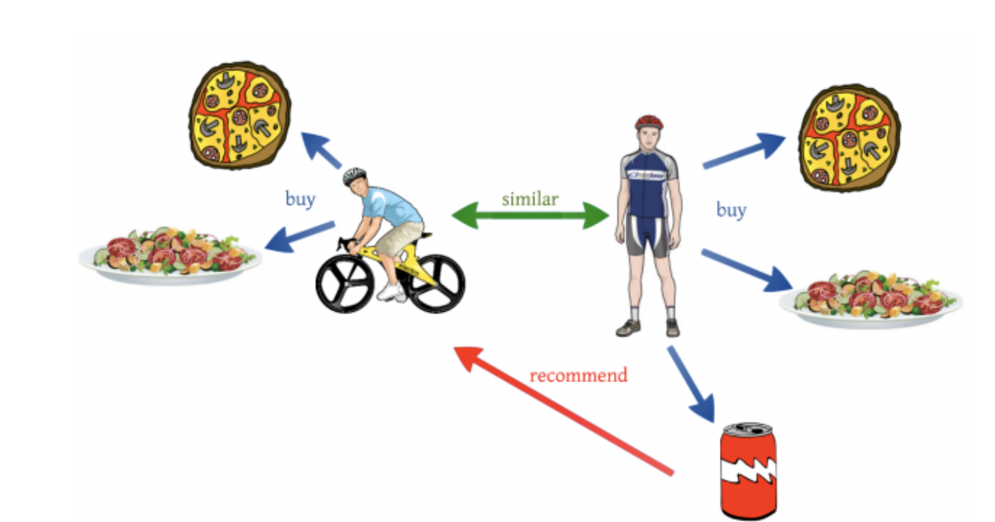
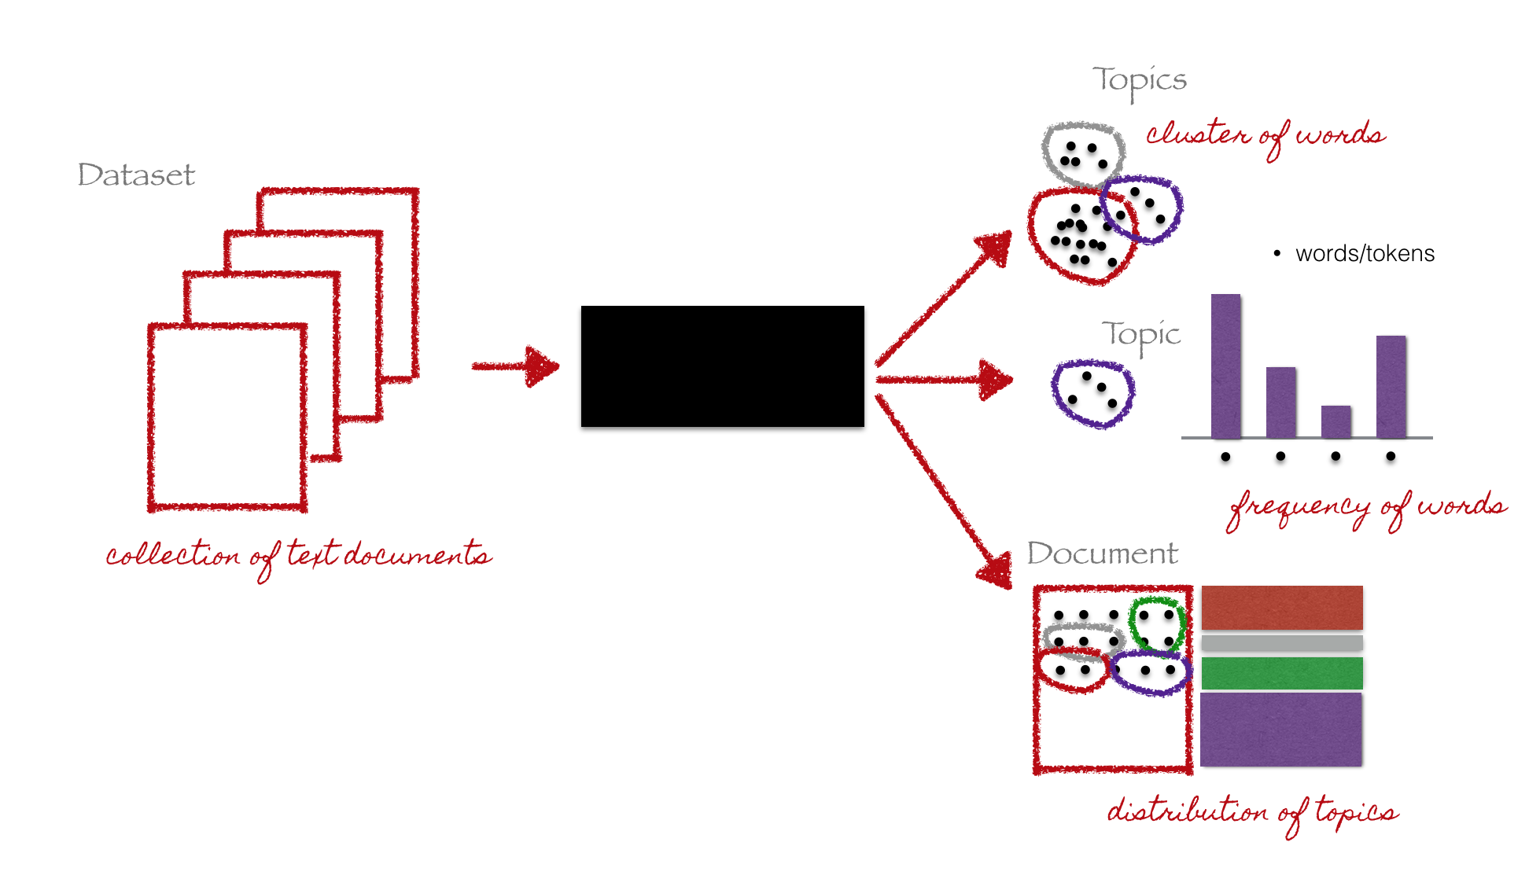
Applications of RBM
Dimensionality Reduction
z
Collaborative filtering
Topic Modelling

Slide 17
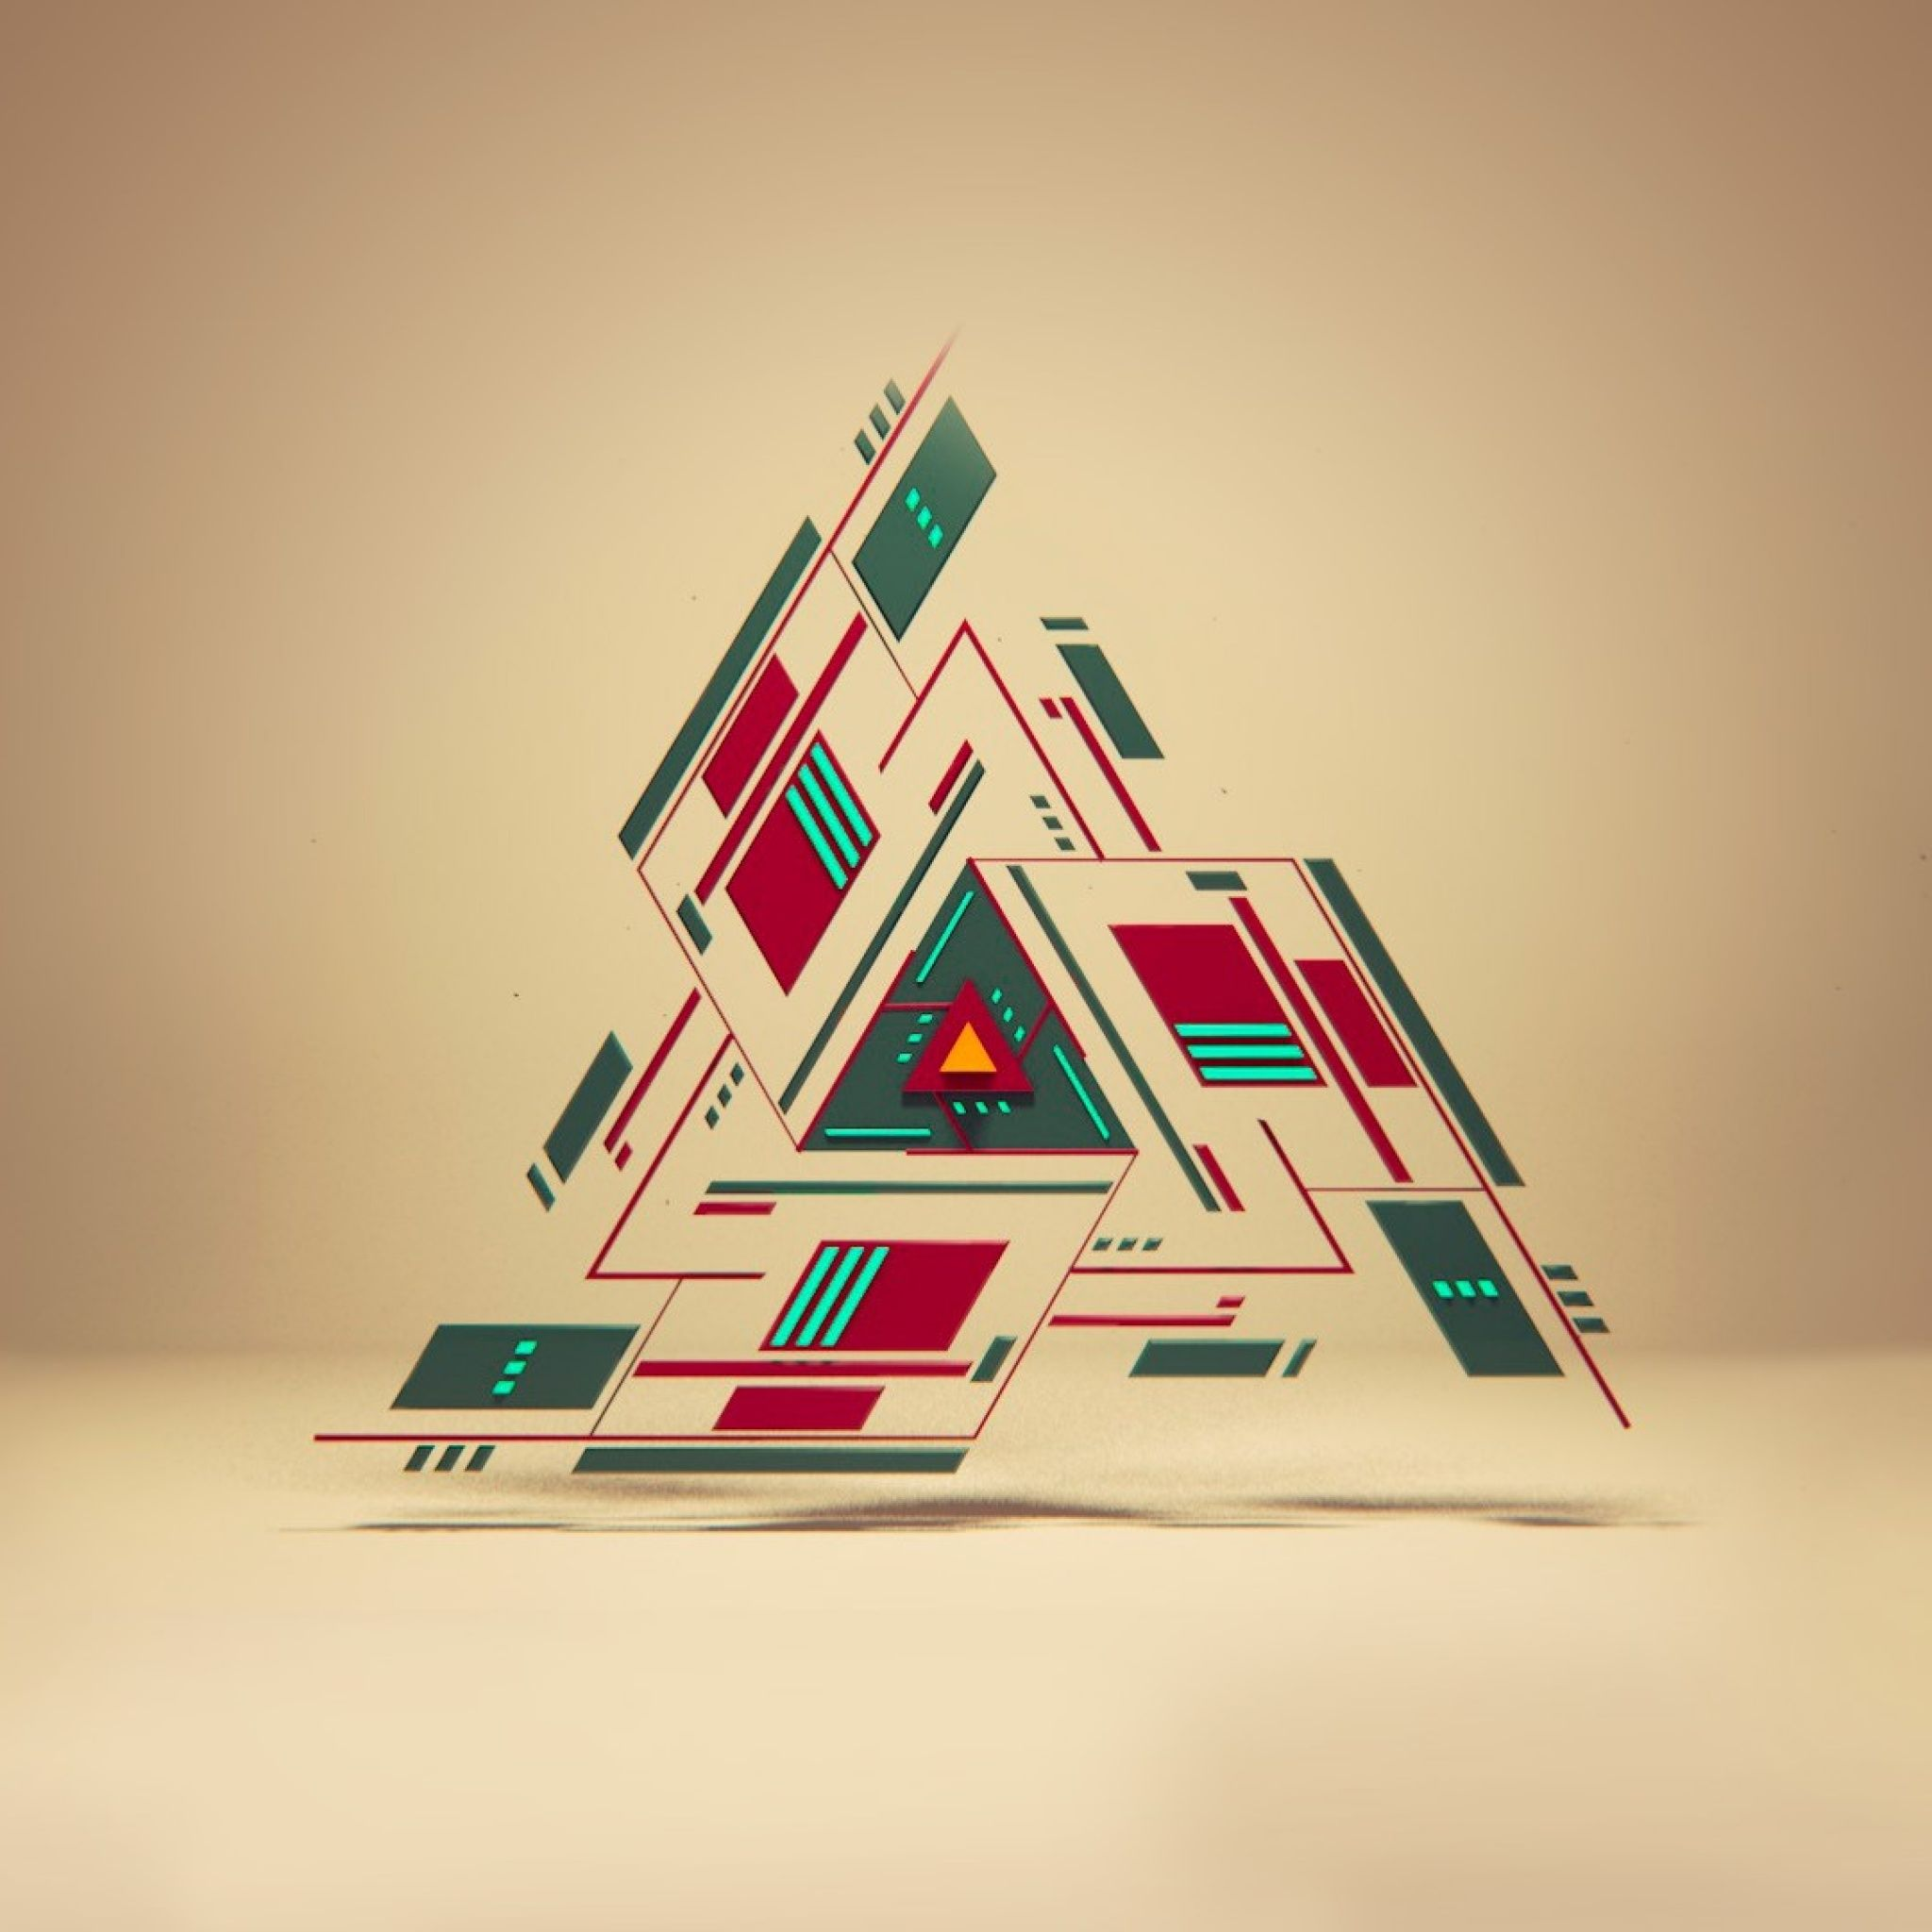
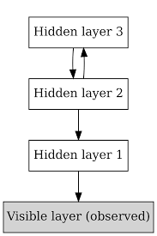
Introduction to Deep Belief Networks
Definition
The Deep Belief Network, or DBN, was also conceived by Geoffrey Hinton.
These powerful nets are believed to be used by Google for their work on the image recognition problem. The method is known as Layer-wise, unsupervised, greedy pre-training.
Composed of multiple layers of latent variables ("hidden units").
DBN can learn to probabilistically reconstruct its inputs.
Each sub-network's hidden layer serves as the visible layer for the next.

Slide 18
Deep Belief Network
Essentially, the DBN is trained two layers at a time, and these two layers are treated like an RBM. After this training process, the DBN is capable of recognizing the inherent patterns in the data. In other words, it’s a sophisticated, multilayer feature extractor.
DBN learns the hidden patterns globally, like a camera slowly bringing an image into focus.
This entire process can be completed in a reasonable amount of time using GPUs, and the resulting net is typically very accurate.
As an added real-world bonus, the training process only requires a small set of labelled data.

Slide 19
Architecture of Deep Belief Network
It is an generative graphical model and works as a solution of vanishing gradient problem.
It is constructed by stacking of more then one RBM.
So, before we go any further lets talk about Vanishing Gradient.
This is a problem of small gradient value which is hard to observe changes on this means that the value of the gradients stops changing.
In some cases this can cause the neural network to stop training further. This problem is seen in DNN’s. Also solves the problem related to back propagation.
Deep Belief Network’s does not have the same problem due to the fact that Deep Belief Networks are made up of successive restricted Boltzmann machines, each trained with Contrastive Divergence before feeding in to the next layer.

Slide 20
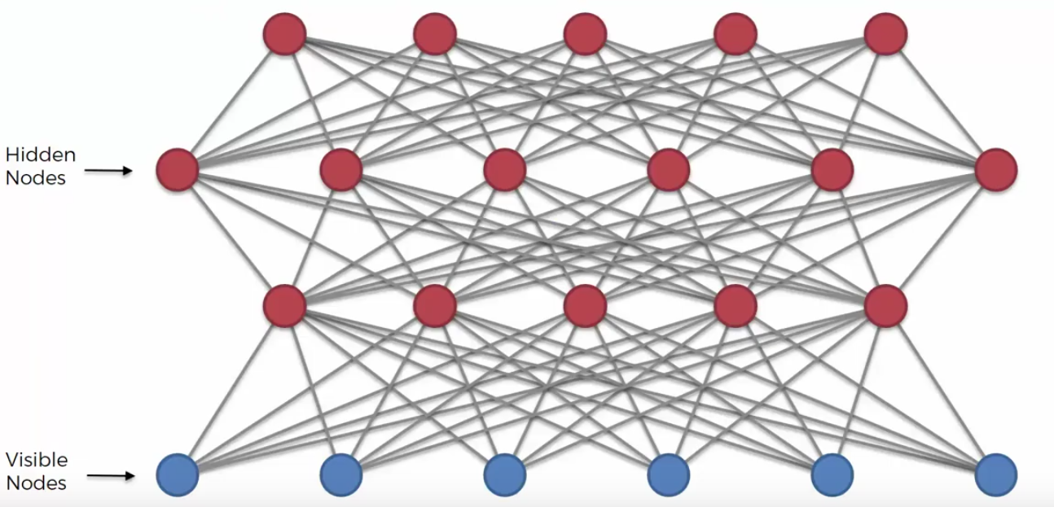
Architecture of DBN

Slide 21
Training of DBN
The input is passed to the visible layer of the first RBM and then we map this to the hidden layer of the first RBM.
We use contrastive divergence to train this RBM. Here the training of RBM means training the optimal weights for these connections.
So in the next RBM the hidden layer from the first RBM acts as the input to the next RBM.
This can continue to the number of RBM that we want to get stacked together.

Slide 22
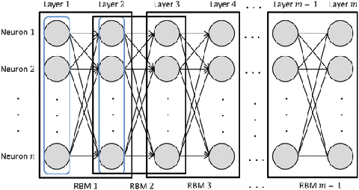
Training of DBN
Recursive Greedy Learning Procedure for DBN
Step one is to train a layer of properties which can obtain the input signals from the pixels directly. This is also the first layer and acts as the visible layer.
Next, we treat the values of this layer as pixels and learn the features of the previous features in a second hidden layer.

Slide 23
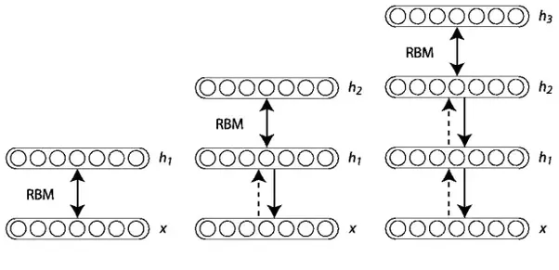
Training of DBN
Every time another layer of properties or features is added to the belief network, there will be an improvement in the lower bound on the log probability of the training data set.

Slide 24
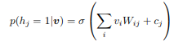
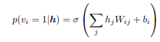
Training of DBN
Contrastive Divergence method
Take the training dataset, set the state of the visible to the training dataset.
Positive Phase: Update all the hidden unit in parallel by using the following equation i.e., compute positive statistics for edge E Positive(E), which is P(H =1|V).
The individual activation probabilities for hidden layer units can be given as:
Negative Phase: Reconstruct the visible units using similar technique, as given in the following equation Compute the negative statistics for edge E Negative(E), which is P(V = 1|H)
The individual activation probabilities for visible layer units can be given as:
Update the weight of edge: The update weight Updt(W) of edge (having previous weight) W can be given as:
Updt(W) = W + L*(Positive(E)-Negative(E)) Where, 'L' is learning rate.

Slide 25
Training of DBN
The DBN is fine-tuned with supervised learning and a small set of labeled examples. After making minor tweaks to the weights and biases, the net will achieve a slight increase in accuracy.
Fine Tuning the system:
Do a stochastic bottom up pass
Adjust the top-down weight
Do a few iterations of the sampling in the top-level RBM
Adjust weights in the top level RBM
Do a stochastic top-down pass
Adjust the bottom-up weights

Slide 26
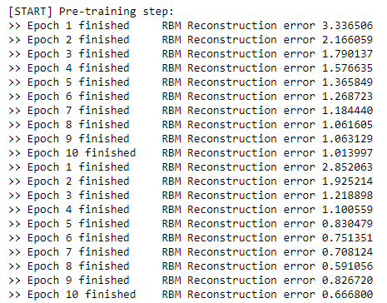
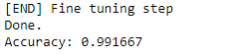
Results of DBN

Slide 27
Applications of DBN
Applications of Deep Belief Networks are as follows:
Image recognition
Video recognition
Motion-capture data

Slide 28
Conclusion
z
The learning procedures of General Boltzmann Machine were too slow and inefficient.
Restricted Boltzmann Machine addresses this issue by having restriction in intra-layer connection.
Deep Belief Networks further used the simplicity of RBMs to further improve the model’s learning capabilities.

Slide 29
Thank you
References:
Salakhutdinov, R., & Hinton, G., 2009. Deep Boltzmann Machines. Artificial intelligence and statistics.
Salakhutdinov, R., & Hinton, G., & Mnih, A., 2007. Restricted Boltzmann Machines. Conference of Machine Learning.
Hinton, G., 2007. Boltzmann Machine. Scholarpedia, Vo. 2(5): page.1668.
https://medium.com/analytics-army/deep-belief-networks-an-introduction-1d52bb867a25
https://github.com/albertbup/deep-belief-network
https://missinglink.ai/guides/neural-network-concepts/deep-belief-networks-work-applications

